Slide 1

PRISM Release Roadmap
Results from PRISM 2020 Annual Meeting
17 June 2020

Slide 2


ITCR Presentation
May, 2020
PRISM Architecture Fundamentals
Lawrence Tarbox, PhD
TCIA/PRISM Architect
Department of Biomedical Informatics
University of Arkansas for Medical Sciences
Notes:
In this presentation we will discuss the technology stack that drives the PRISM platform.

Slide 3
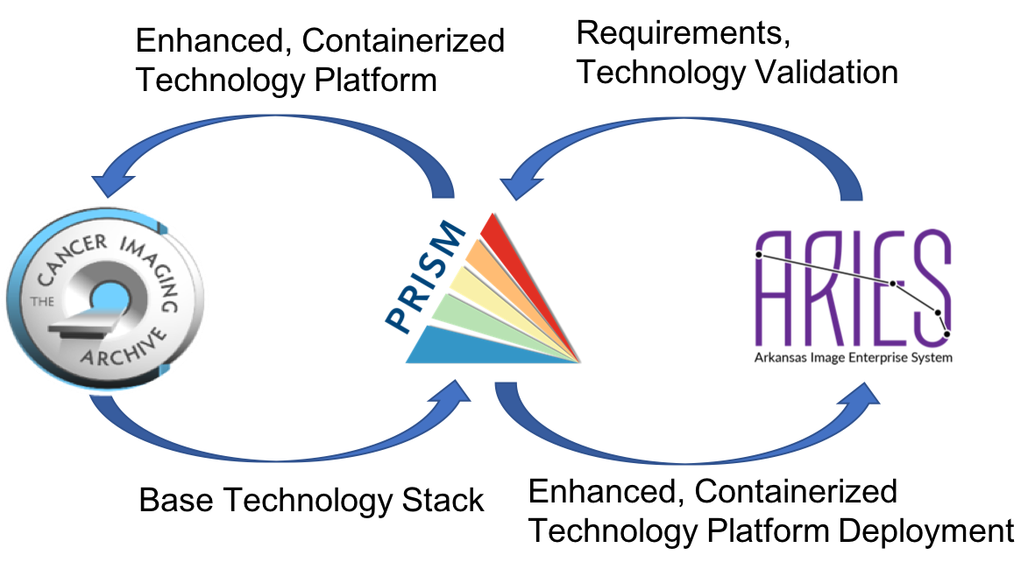
Relationship Between TCIA and PRISM
The current TCIA technology stack serves as the starting point for PRISM – this is what we can deploy today, and we have at UAMS and Stonybrook
TCIA is a primary, but not the only driving force behind PRISM (RAC inputs, deployment sites)
PRISM is being developed in parallel with continued TCIA operations
Initial deployments of PRISM will be to other (non-TCIA) repositories
TCIA will migrate to the PRISM technology stack in a piecewise manner
ARIES
SBRIES
Other PRISM deployments
Notes:
Although PRISM started with the TCIA technology stack, TCIA is only one of many forces driving PRISM. TCIA continues to operate using its current stack in parallel with PRISM development. The initial deployments of PRISM are not slated for TCIA, but TCIA will gradually migrate to the PRISM stack.

Slide 4
PRISM Deployment: Kubernetes Cluster
Kubernetes is an open source orchestration system for Docker containers.
It manages containerized applications across multiple hosts and provides basic mechanisms for deployment, maintenance, and scaling of applications.
Notes:
PRISM primarily consists of containers orchestrated in a Kubernetes Cluster, taking advantage of Kubernetes services and that help with the deployment, management, and high availability operation of complex workflows such as PRISM.

Slide 5
Core Services
Authentication & Authorization Services
Logging Services
Database Services
Shibboleth IdP
(InCommon ID Provider)
Keycloak
(InCommon Service Provider)
Keycloak Gatekeeper
Kibana
Logstash
SQL (Postgres/Mariadb)
NoSQL Documents (Mongo)
Graph DB
Red Hat ID Manager
(LDAP)
Elasticsearch
Bulk Storage
(S3-based objects)
Notes:
Certain services form the core of PRISM that other services build upon. Authentication and Authorization are centralized using Keycloak tied via LDAP to Red Hat Identity Manger. PRISM repositories can use Open ID Connect or federated user IDs from InCommon via SAML 2.0. The PRISM core includes centralized logging services via Logstash and Elasticsearch, with the ability to analyze those logs using Kibana. The logging services not only are used for diagnostics, but also for use statistics. The core provides database services as well as bulk storage management for large objects.

Slide 6
Backend Services
API Gateway / Load Balancing (Kong on Nginx)
Data Download Services
Misc.
APIs
In Progress
DICOM Services
Semantic Search Services
Pathology Services
DICOMweb™
(dcm4chee 5)
Backend Image Sharing (Kheops w/OHIF)
Collection Management
(currently NBIA APIs)
Pathology Tools
(QuIP)
Whole Slide Viewing backend
Bindaas
Aspera Faspex
Aspera HSTS
(on bare metal for speed)
Path DB
Core Services
Notes:
PRSIM backend services are accessed via RESTful APIs through a load-balancing gateway. PRISM applications can optionally use Aspera Faspex and High Speed Transfer Server to increase download performance. PRISM will also include downloading options that do not utilize Aspera. DICOM data will be available through a DICOMweb™ interface provided by a dcm4chee 5 archive server. Kheops and NBIA provide DICOM data sharing services. Additional backend tools can manage and analyze Pathology images and related data. Semantic search capabilities, described in a separate presentation, are planned. The backend services can be extended as needed and will be constantly evolving, either through new API services or APIs configured through the Bindaas system.

Slide 7
Frontend Services (GUIs)
API Gateway / Load Balancing (Kong on Nginx)
Publishing
Services
Support
Services
Data Browsing Services
Image
Viewing
Services
Future Expansion
Data Visualization
(DataScope)
Image Sharing
(Kheops)
Legacy Browsing
(NBIA Search)
Datacite
Wiki
WordPress
(landing pages)
JIRA ServiceDesk
Usage Statistics
caMicroscope
OHIF
Core Services
Backend Services
Notes:
Frontend services leverage the backend and core services to provide the user experience for PRISM-based repositories, including data browsing and visualization, as well as user support through landing pages, helpdesks, and other documentation. RESTful APIs facilitate future expansion and evolution. We welcome contributions and suggestions.

Slide 8
Release Plan
Release 0.5P – Pathology only deployment – December 2020
Release 0.5R - Radiology only deployment – December 2020
Release 1.0 – complete Rad/Path functional package – June 2021 (ITCR annual)
Release 1.5 – Semantic integration, feature base and expanded UI model - December 2021

Slide 9
Release 0.5P
QuIP components and PRISM core services deployable as a Kubernetes deployment object
Initial release of Core Services: Authentication, Bulk Storage
Backend services limited to: Pathology, APIs and Download services
  Enhanced API for IDC support
Front end services:
  DataScope based, 3 tier UI Model (basic path only version)
  caMicroscope viewer
  Basic support services
Initial Pathology curation support in Posda

Slide 10
Release 0.5R
Same Core Services as 0.5P
Backend same as 0.5P with DICOM services replacing Pathology services
Front end services:
  DataScope based, 3 tier UI Model (basic Rad only version)
  OHIF viewer
  Basic support services

Slide 11
Application of 0.5 Releases to TCIA
Portions of these releases can be added to TCIA
  Latest OHIF
  NLST will be moved to PRISM Authentication services
  Pathology UI updates
In some cases they are being deployed as they come on-line
  MariaDB + MaxScale servers that production NBIA will be using in the near future will be deployed on K8s and form part of the Core DB service
  Pathology and clinical data curation in Posda
Notes:
We are allowing deployments, such as TCIA, ARIES, and SBRIES, to cherry pick which portions of PRISM they will use. So TCIA might not be using all of the 0.5 PRISM release, but it certainly could be using portions of it.

Slide 12
Release 1.0
Complete Core Services
Integrate Backend Services for Rad/Path
Front end services:
  Integrated 3 tier UI Model
  Data publication services
  Expanded support services (using expanded Core)
Full pathology support in Posda

Slide 13
Release 1.5
Semantic integration, feature base and Complete UI model
All currently defined services in place
Complete API
Basic integration with analysis pipelines via API
Full clinical information and feature curation support in Posda
Notes:
Semantic functionality will be deployed first in ARIES for validation prior to integration into TCIA

Slide 14
Bug fixes, UI improvements
Other Architectural Improvements
e.g. Kubernetes
Non-DICOM Support
e.g. Pathology, Spreadsheet, JSON
Posda Release Roadmap
0.8.x production ready
Timepoint as UOD
0.7.x
0.8.x production ready
Worker Nodes
0.8.x
Archive Activity Clusters
0.9.x
1.0

